Slide 1
Linear Regression
Content created by: Mélanie Roschewitz, Kamilė Stankevičiūtė, Sonal Joshi, Owais Hussain

Slide 2

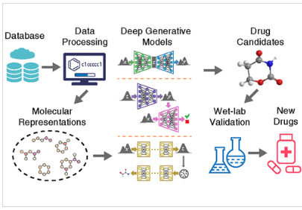



Generative ML tasks
Image generation
Text-to-speech
Conversational agents
Drug design
Generate image given text instructions
Write the transcript of this recording
Finding molecules targeting a disease
“A cat sitting on a table”
Schema from Deep Generative Models in De Novo Drug Molecule Generation, Pang et al, 2023 https://pubs.acs.org/doi/10.1021/acs.jcim.3c01496

Slide 3

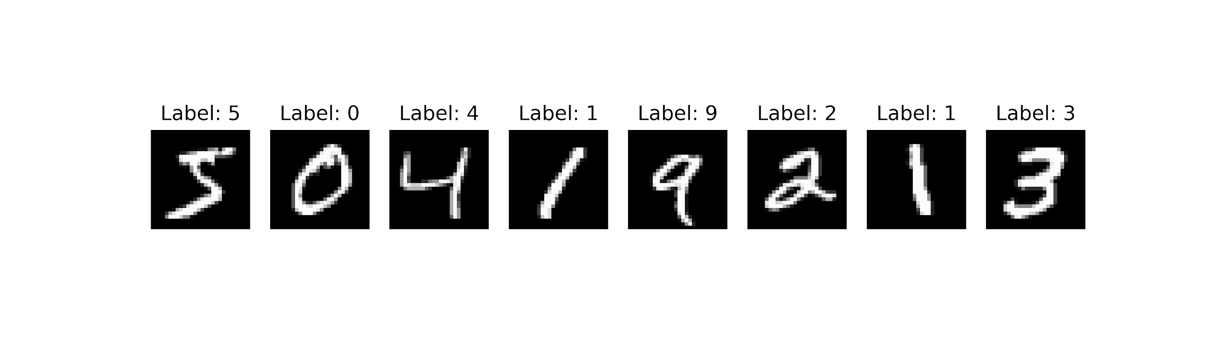
Generative vs Discriminative models
Discriminative models
Designed to learn the mapping from inputs (e.g. images) to labels (=annotations), in order to predict the labels for new examples.
It’s a 5 !
input image
output label
Discriminative
ML model
(at test time)

Slide 4
Generative vs Discriminative models
Discriminative models
We normally train them using supervised machine learning algorithms where both inputs and the “ground truth” outputs are available.
https://yann.lecun.com/exdb/mnist/

Slide 5
Generative vs Discriminative models
Discriminative models
We normally train them using supervised machine learning algorithms where both inputs and the “ground truth” outputs are available.
If the labels are categories → classification
If the labels are continuous → regression
If the labels are objects name + localisation → object detection
https://yann.lecun.com/exdb/mnist/

Slide 6

Generative vs Discriminative models
Generative models
Learn the patterns in the data in order to generate new examples representative of the original dataset.
This is an unsupervised learning task—no “correct answers”.
https://cdn.openai.com/papers/dall-e-3.pdf
Notes:
https://www.wired.com/story/deepfakes-getting-better-theyre-easy-spot/

Slide 7
In this course
Introduction to most of these models in the next sessions
First part focused on discriminative tasks (regression, classification)
Second part introduction to generative models for text and image generation

Slide 8
Survey
You have conducted a survey in your class and collected the following
Next, you plot these two variables on a graph
Question! Can you tell Summiya’s score?
Student | Hours of Study | Exam Score
Abdullah | 2 | 67
Aroob | 4 | 62
Aminah | 3 | 61
Azka | 6 | 93
Summiya | 5 | ??
Owais | 4 | 76
Tim | 7 | 71
Liza | 3 | 69
Martin | 1 | 52

Slide 9
Survey
YES. You can predict Summiya’s score with certain accuracy
Let’s plot a trend line and see where the coordinates meet
74

Slide 10
Survey
Summiya’s actual score was 70
This still give us an above 90% accurate prediction
But where did this Trend line come from?
Let us look at what’s behind the scenes

Slide 11
And the first step is...
The equation of a line

Slide 12
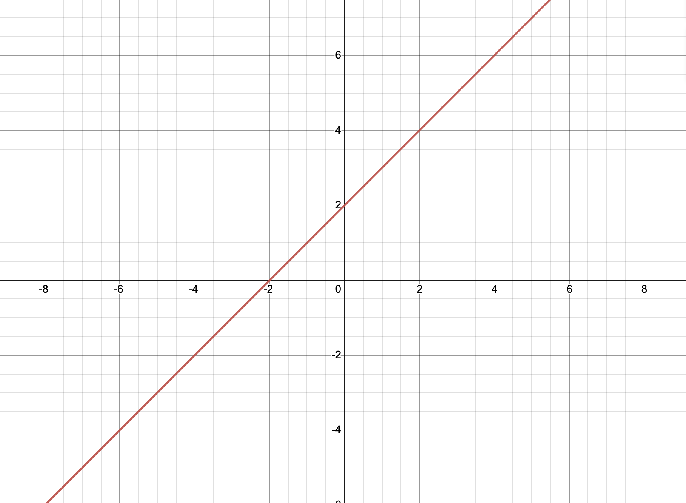
Equation of a line
Y-axis
y = mx + c
here, m (a.k.a. slope/gradient)
m = rise / run = 2 / 2 = 1
c = 2
y = mx + c
X-axis

Slide 13
Linear Regression

Slide 14
Regression
In discriminative tasks, our goal is to learn a mapping function f(x) to be able to predict the value of y from the value of x
When y is a continuous value, then learning this function is a regression task.
Some examples:
F1 car’s speed = f (how hard the racer presses accelerator, engine power)
A flat’s price = f (location of the flat, size of the flat, interior design)
Tesla’s share price = f (general market trend, Tesla’s finance report, Bitcoin)
Notes:
Machine learning is about inferring
the underlying function that maps some input variable x to some output variable y

Slide 15
Linear model
One of the simplest (yet one of the most important!) models in machine learning
We have N observations of the form (x_{i} , y_{i} ):
where, for i^{th} observation, x_{i} is the input and y_{i} is the label / output.
We assume that the label can be obtained through a linear transformation of the feature:
y_{i}= ax_{i}+ b + 𝜀_{i}
Where 𝜀_{i} is some very small noise, called the residual noise. It adds fuzziness to introduce some real-world randomness in our equation
In this setting we assume that the mapping to learn f(x) is of the form f(x) = ax+b
Our goal is to learn a and b from the data

Slide 16
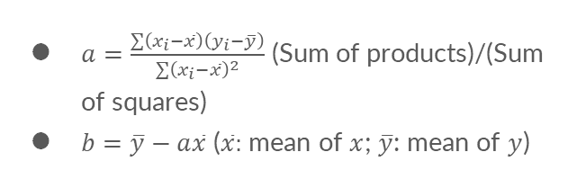
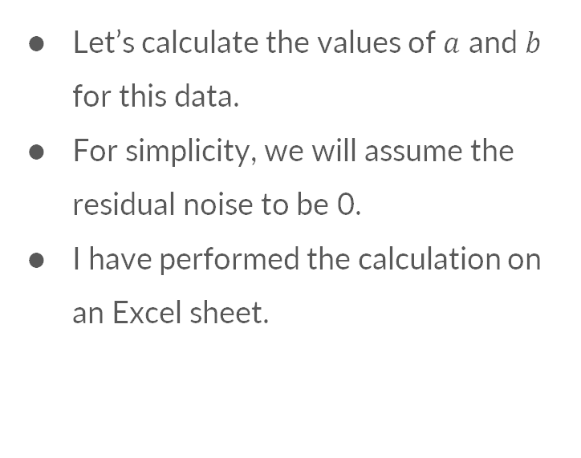
Example: Linear model for Survey
$a=\frac{∑\left(x_{i}−\overline{x}\right)\left(y_{i}−\overline{y}\right)}{∑{\left(x_{i}−\overline{x}\right)}^{2}}$ (Sum of products)/(Sum of squares)
$b=\overline{y}−a\overline{x}$ ($\overline{x}:$ mean of $x$; $\overline{y}$: mean of $y$)
Let’s calculate the values of $a$ and $b$ for this data.
For simplicity, we will assume the residual noise to be 0.
I have performed the calculation on an Excel sheet.

Slide 17
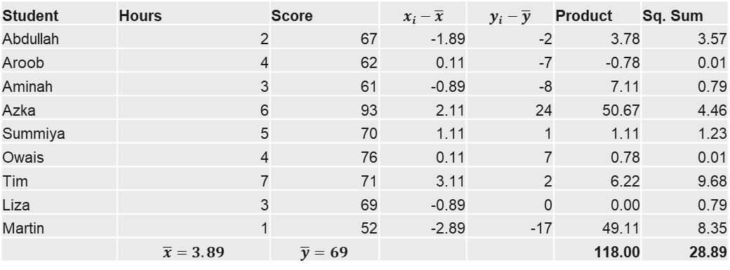
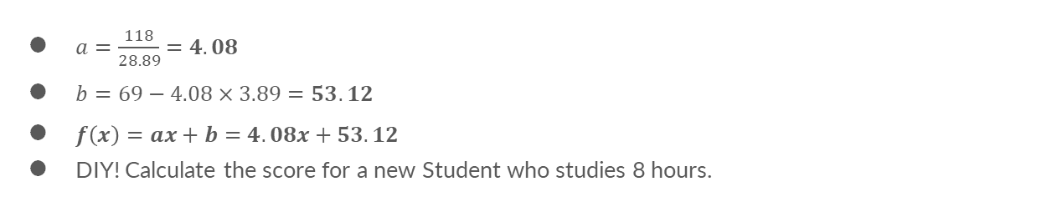
Example: Linear model for Survey
Student | Hours | Score | $$x_{i}−\overline{x}$$ | $$y_{i}−\overline{y}$$ | Product | Sq. Sum
Abdullah | 2 | 67 | -1.89 | -2 | 3.78 | 3.57
Aroob | 4 | 62 | 0.11 | -7 | -0.78 | 0.01
Aminah | 3 | 61 | -0.89 | -8 | 7.11 | 0.79
Azka | 6 | 93 | 2.11 | 24 | 50.67 | 4.46
Summiya | 5 | 70 | 1.11 | 1 | 1.11 | 1.23
Owais | 4 | 76 | 0.11 | 7 | 0.78 | 0.01
Tim | 7 | 71 | 3.11 | 2 | 6.22 | 9.68
Liza | 3 | 69 | -0.89 | 0 | 0.00 | 0.79
Martin | 1 | 52 | -2.89 | -17 | 49.11 | 8.35
 | $$\overline{x}=3.89$$ | $$\overline{y}=69$$ |  |  | 118.00 | 28.89
$a=\frac{118}{28.89}=4.08$
$b=69−4.08×3.89=53.12$
$f\left(x\right)=ax+b=4.08x+53.12$
DIY! Calculate the score for a new Student who studies 8 hours.

Slide 18
Implementation on Google Colab
Objective 1: Learn a Linear model to predict Exam score using StudyHours Objective 2: Test the model using different values for StudyHours between 1 and 10

Slide 19
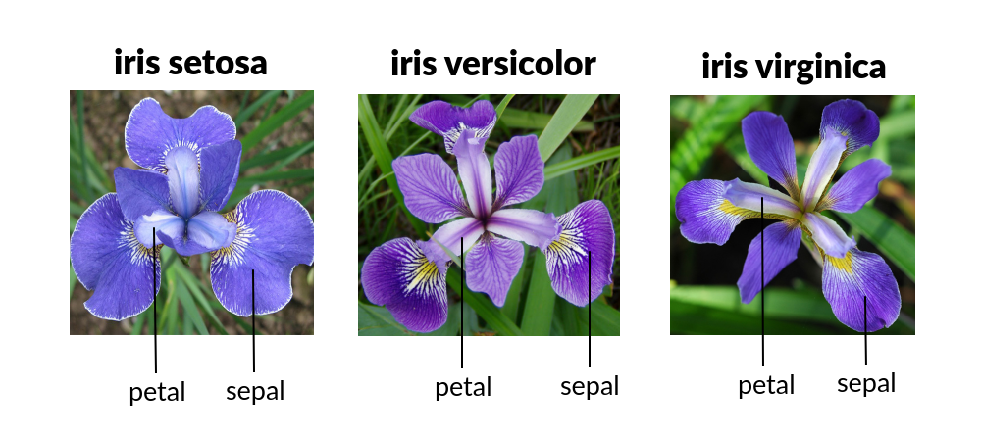
Example: The iris dataset
Iris dataset was introduced in 1936 by a British statistician, Ronald Fisher. It is very well-known in the ML community.
It has 150 records of flowers of Iris plants of 3 species: Setosa, Versicolor and Virginica.
Additionally, each flower has a Petal and a Sepal; the data contains their Lengths and Heights.

Slide 20
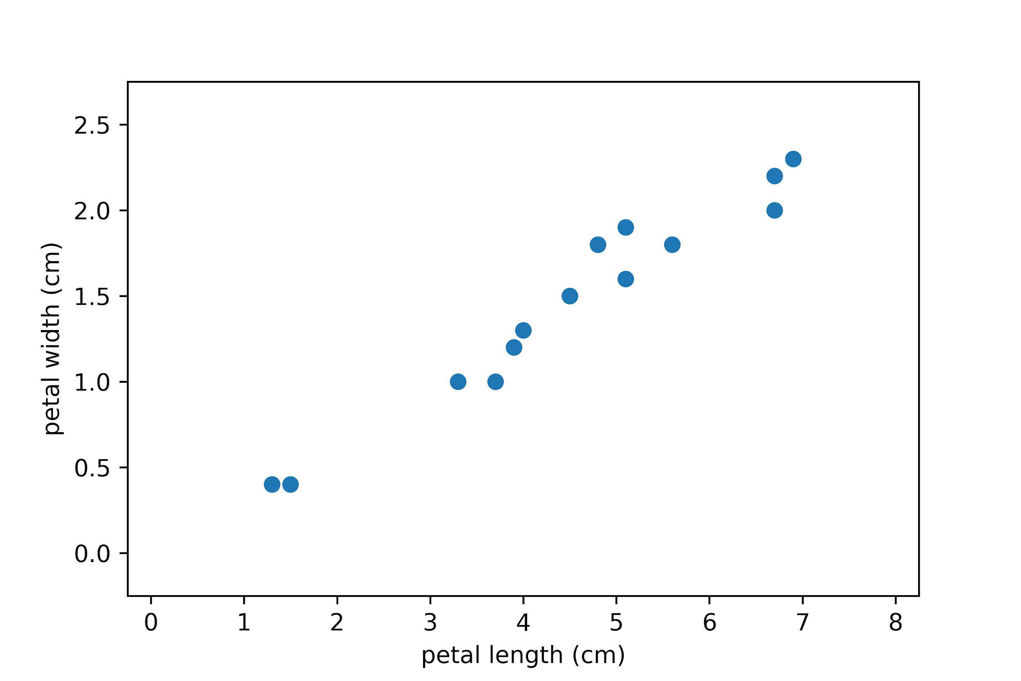
Example: The iris dataset
Predicting the width from the petal length. Which one of these is the input, and which one is the label?
Observation i = 1
with petal length = 1.2 cm
and petal width = 0.4 cm.
So
x₁ = 1.2 cm, y₁ = 0.4 cm

Slide 21
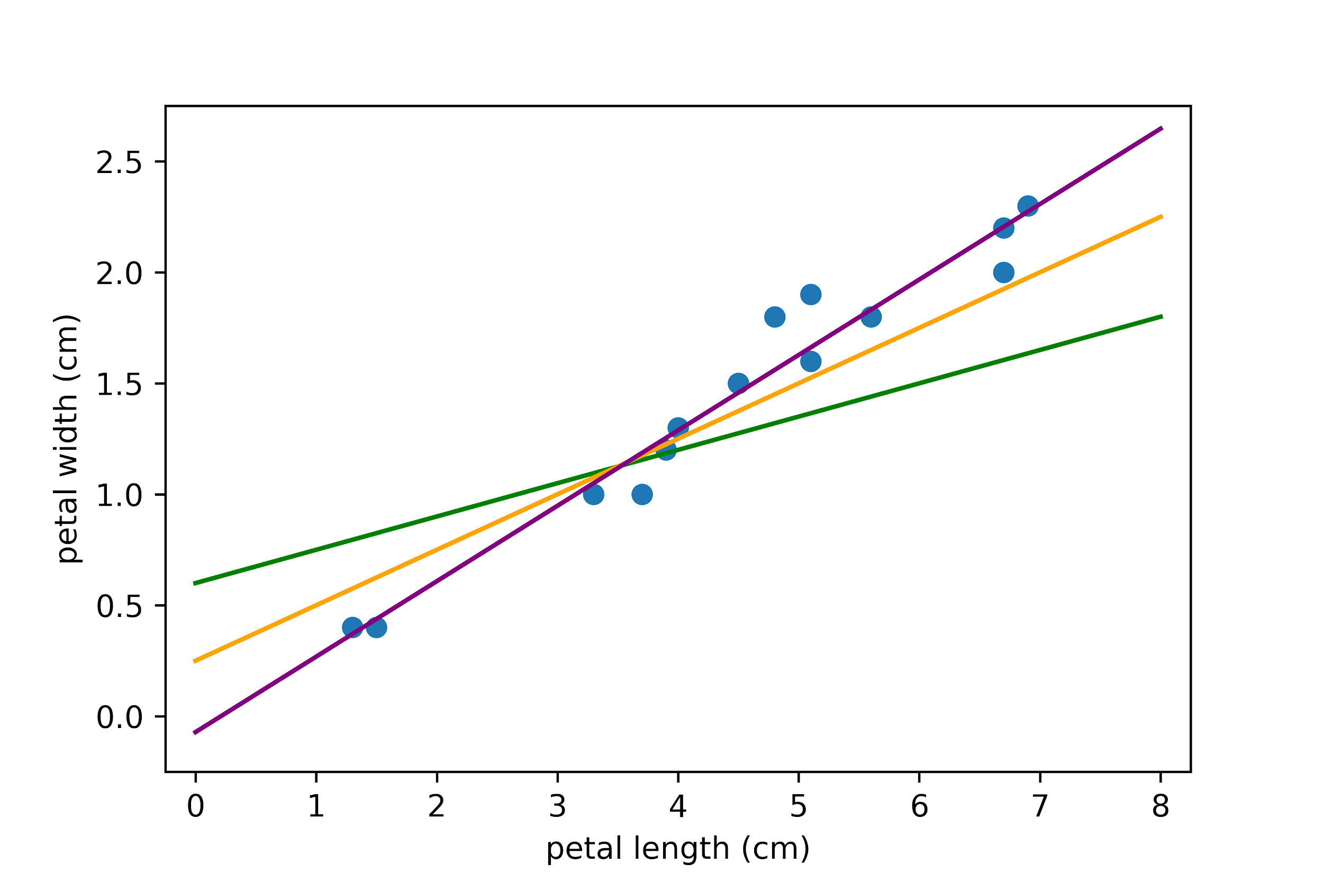
Choosing the line of best fit
Which line looks the best? Why? Can we quantify this?

Slide 22
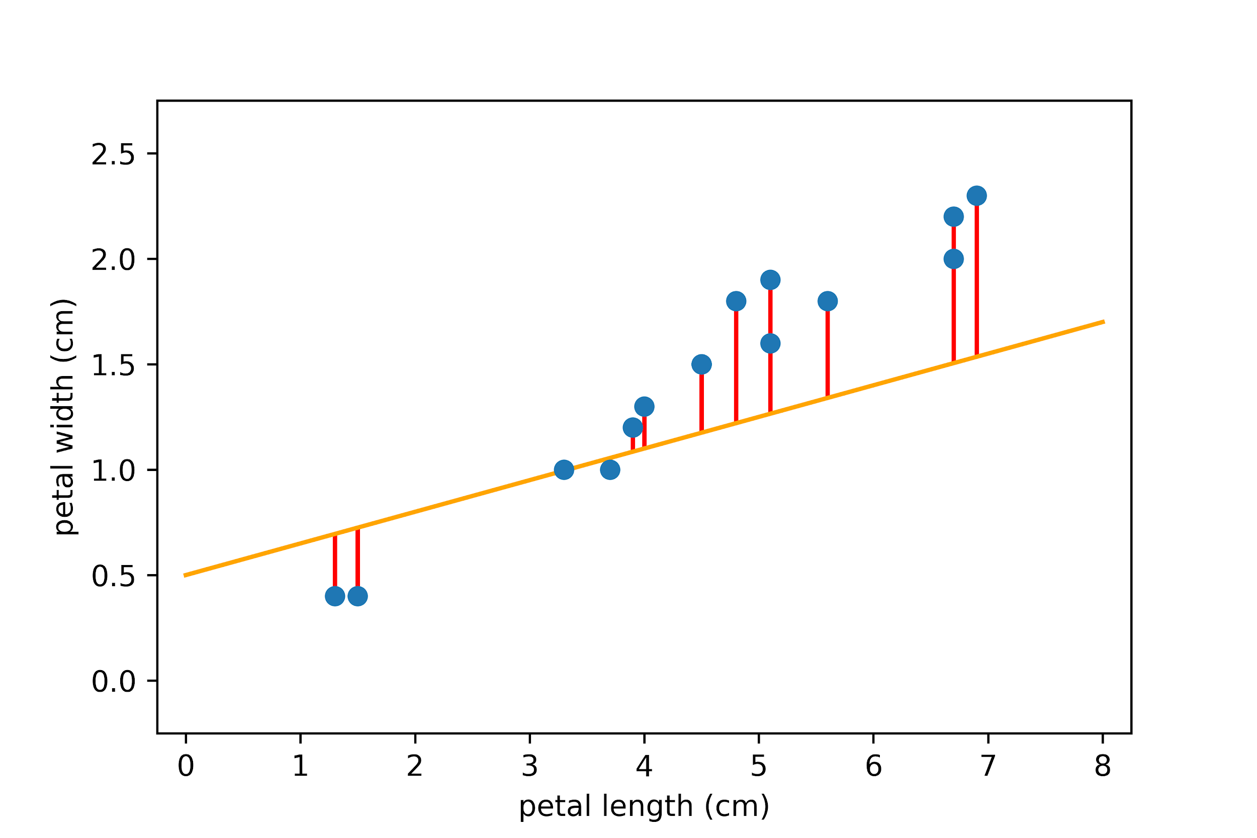
Measuring the residuals
The difference between the predicted value ŷ_{i} and the true value y_{i} : (ŷ_{i} - y_{i} ) is called the residual.
For observation 3:
x₃ = 3.4, y₃ = 0.98, ŷ₃ = 0.98 → ŷ₃ - y₃ = 0
For observation 14:
x₁₄ = 6.9, y₁₄ = 2.25 ŷ₁₄ = 0.5 + 0.14 * 6.9 = 1.47 ŷ₁₄ - y₁₄ = 2.25 - 1.47 = 0.78
Orange line is y = 0.5 + 0.14x
The smallest the sum of the residuals, the best is the model !

Slide 23
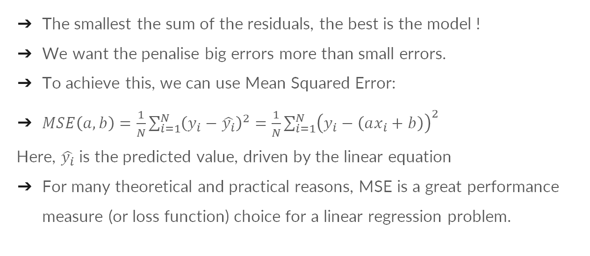
Mean squared error (MSE)
The smallest the sum of the residuals, the best is the model !
We want the penalise big errors more than small errors.
To achieve this, we can use Mean Squared Error:
$MSE\left(a,b\right)=\frac{1}{N}\sum_{i=1}^{N}{{\left(y_{i}−\hat{y_{i}}\right)}^{2}}=\frac{1}{N}\sum_{i=1}^{N}{{\left(y_{i}−\left(ax_{i}+b\right)\right)}^{2}}$
Here, $\hat{y_{i}}$ is the predicted value, driven by the linear equation
For many theoretical and practical reasons, MSE is a great performance measure (or loss function) choice for a linear regression problem.
Notes:
Could put a side comment here to reinforce the key ML concepts of 1) task 2) experience 3) performance measure. MSE is the performance measure. What are the task and experience in the iris dataset example?

Slide 24
Mean squared error (MSE)
MSE is widely used due to the following properties:
Easy to calculate
The magnitude of the error is more important than the direction of error.
The penalty increases quadratically as the distance between the point and the line increases (more small residuals are preferable to one large residual).

Slide 25
How do we find the best coefficients?
Goal:
We want to estimate the coefficients a and b such that MSE is minimised.
The estimate of the coefficients at which MSE is minimal is called the least squares estimate.
How we get there:
Find the values a and b that minimise MSE → where gradient is zero.
Since MSE depends on two variables, we will use partial derivatives.
Notes:
Introduce the notion of taking the derivative of MSE and taking the coefficients where it is the smallest.
Possible remark that we can do this because MSE is convex so there is only one minimum.

Slide 26
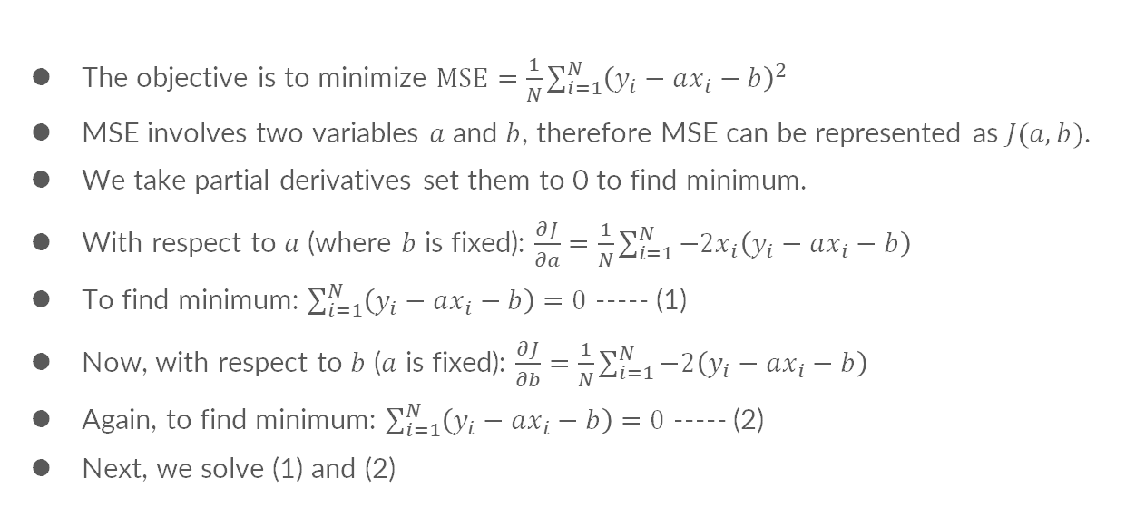
Computing the least squares estimate
The objective is to minimize $MSE=\frac{1}{N}\sum_{i=1}^{N}{{\left(y_{i}−ax_{i}−b\right)}^{2}}$
MSE involves two variables $a$ and $b$, therefore MSE can be represented as $J(a,b)$.
We take partial derivatives set them to 0 to find minimum.
With respect to $a$ (where $b$ is fixed): $\frac{∂J}{∂a}=\frac{1}{N}\sum_{i=1}^{N}{−2x_{i}\left(y_{i}−ax_{i}−b\right)}$
To find minimum: $\sum_{i=1}^{N}{\left(y_{i}−ax_{i}−b\right)}=0$ ----- (1)
Now, with respect to $b$ ($a$ is fixed): $\frac{∂J}{∂b}=\frac{1}{N}\sum_{i=1}^{N}{−2\left(y_{i}−ax_{i}−b\right)}$
Again, to find minimum: $\sum_{i=1}^{N}{\left(y_{i}−ax_{i}−b\right)}=0$ ----- (2)
Next, we solve (1) and (2)

Slide 27
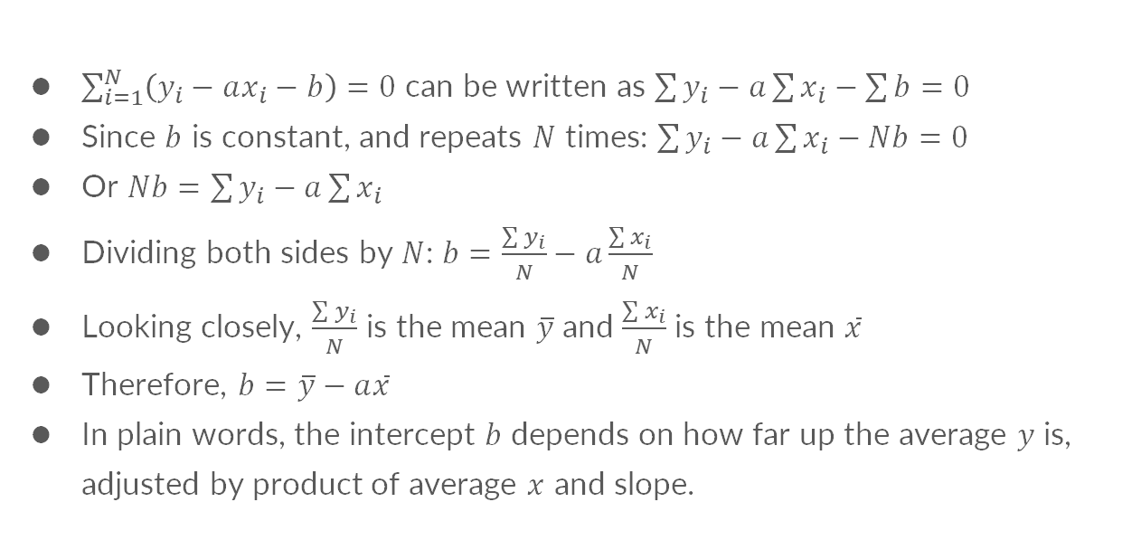
Computing the least squares estimate
$\sum_{i=1}^{N}{\left(y_{i}−ax_{i}−b\right)}=0$ can be written as $\sum{y_{i}}−a\sum{x_{i}}−\sum{b}=0$
Since $b$ is constant, and repeats $N$ times: $\sum{y_{i}}−a\sum{x_{i}}−Nb=0$
Or $Nb=\sum{y_{i}}−a\sum{x_{i}}$
Dividing both sides by $N$: $b=\frac{\sum{y_{i}}}{N}−a\frac{\sum{x_{i}}}{N}$
Looking closely, $\frac{\sum{y_{i}}}{N}$ is the mean $\overline{y}$ and $\frac{\sum{x_{i}}}{N}$ is the mean $\overline{x}$
Therefore, $b=\overline{y}−a\overline{x}$
In plain words, the intercept $b$ depends on how far up the average $y$ is, adjusted by product of average $x$ and slope.

Slide 28
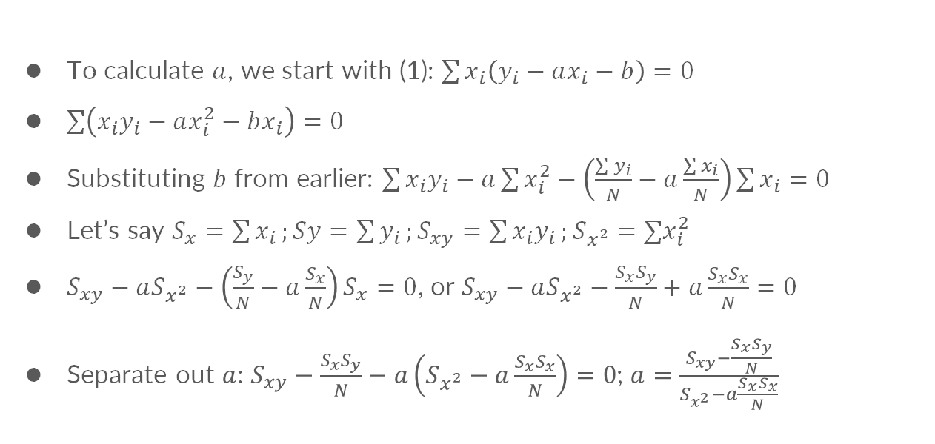
Computing the least squares estimate
To calculate $a$, we start with (1): $\sum{x_{i}\left(y_{i}−ax_{i}−b\right)}=0$
$\sum{\left(x_{i}y_{i}−ax_{i}^{2}−bx_{i}\right)}=0$
Substituting $b$ from earlier: $\sum{x_{i}y_{i}}−a\sum{x_{i}^{2}}−\left(\frac{\sum{y_{i}}}{N}−a\frac{\sum{x_{i}}}{N}\right)\sum{x_{i}}=0$
Let’s say $S_{x}=\sum{x_{i}};Sy=\sum{y_{i}};S_{xy}=\sum{x_{i}y_{i}};S_{x^{2}}=∑x_{i}^{2}$
$S_{xy}−aS_{x^{2}}−\left(\frac{S_{y}}{N}−a\frac{S_{x}}{N}\right)S_{x}=0$, or $S_{xy}−aS_{x^{2}}−\frac{S_{x}S_{y}}{N}+a\frac{S_{x}S_{x}}{N}=0$
Separate out $a$: $S_{xy}−\frac{S_{x}S_{y}}{N}−a\left(S_{x^{2}}−a\frac{S_{x}S_{x}}{N}\right)=0$; $a=\frac{S_{xy}−\frac{S_{x}S_{y}}{N}}{S_{x^{2}}−a\frac{S_{x}S_{x}}{N}}$

Slide 29

Computing the least squares estimate
Substituting original equations back:
$a=\frac{\sum{x_{i}y_{i}}−\frac{∑x_{i}∑y_{i}}{N}}{∑x_{i}^{2}−\frac{{\left(∑x_{i}\right)}^{2}}{N}}$
Which is equivalent to $a=\frac{∑\left(x_{i}−\overline{x}\right)\left(y_{i}−\overline{y}\right)}{∑{\left(x_{i}−\overline{x}\right)}^{2}}$
Notes:
Note! This is an alternate formula for slope

Slide 30
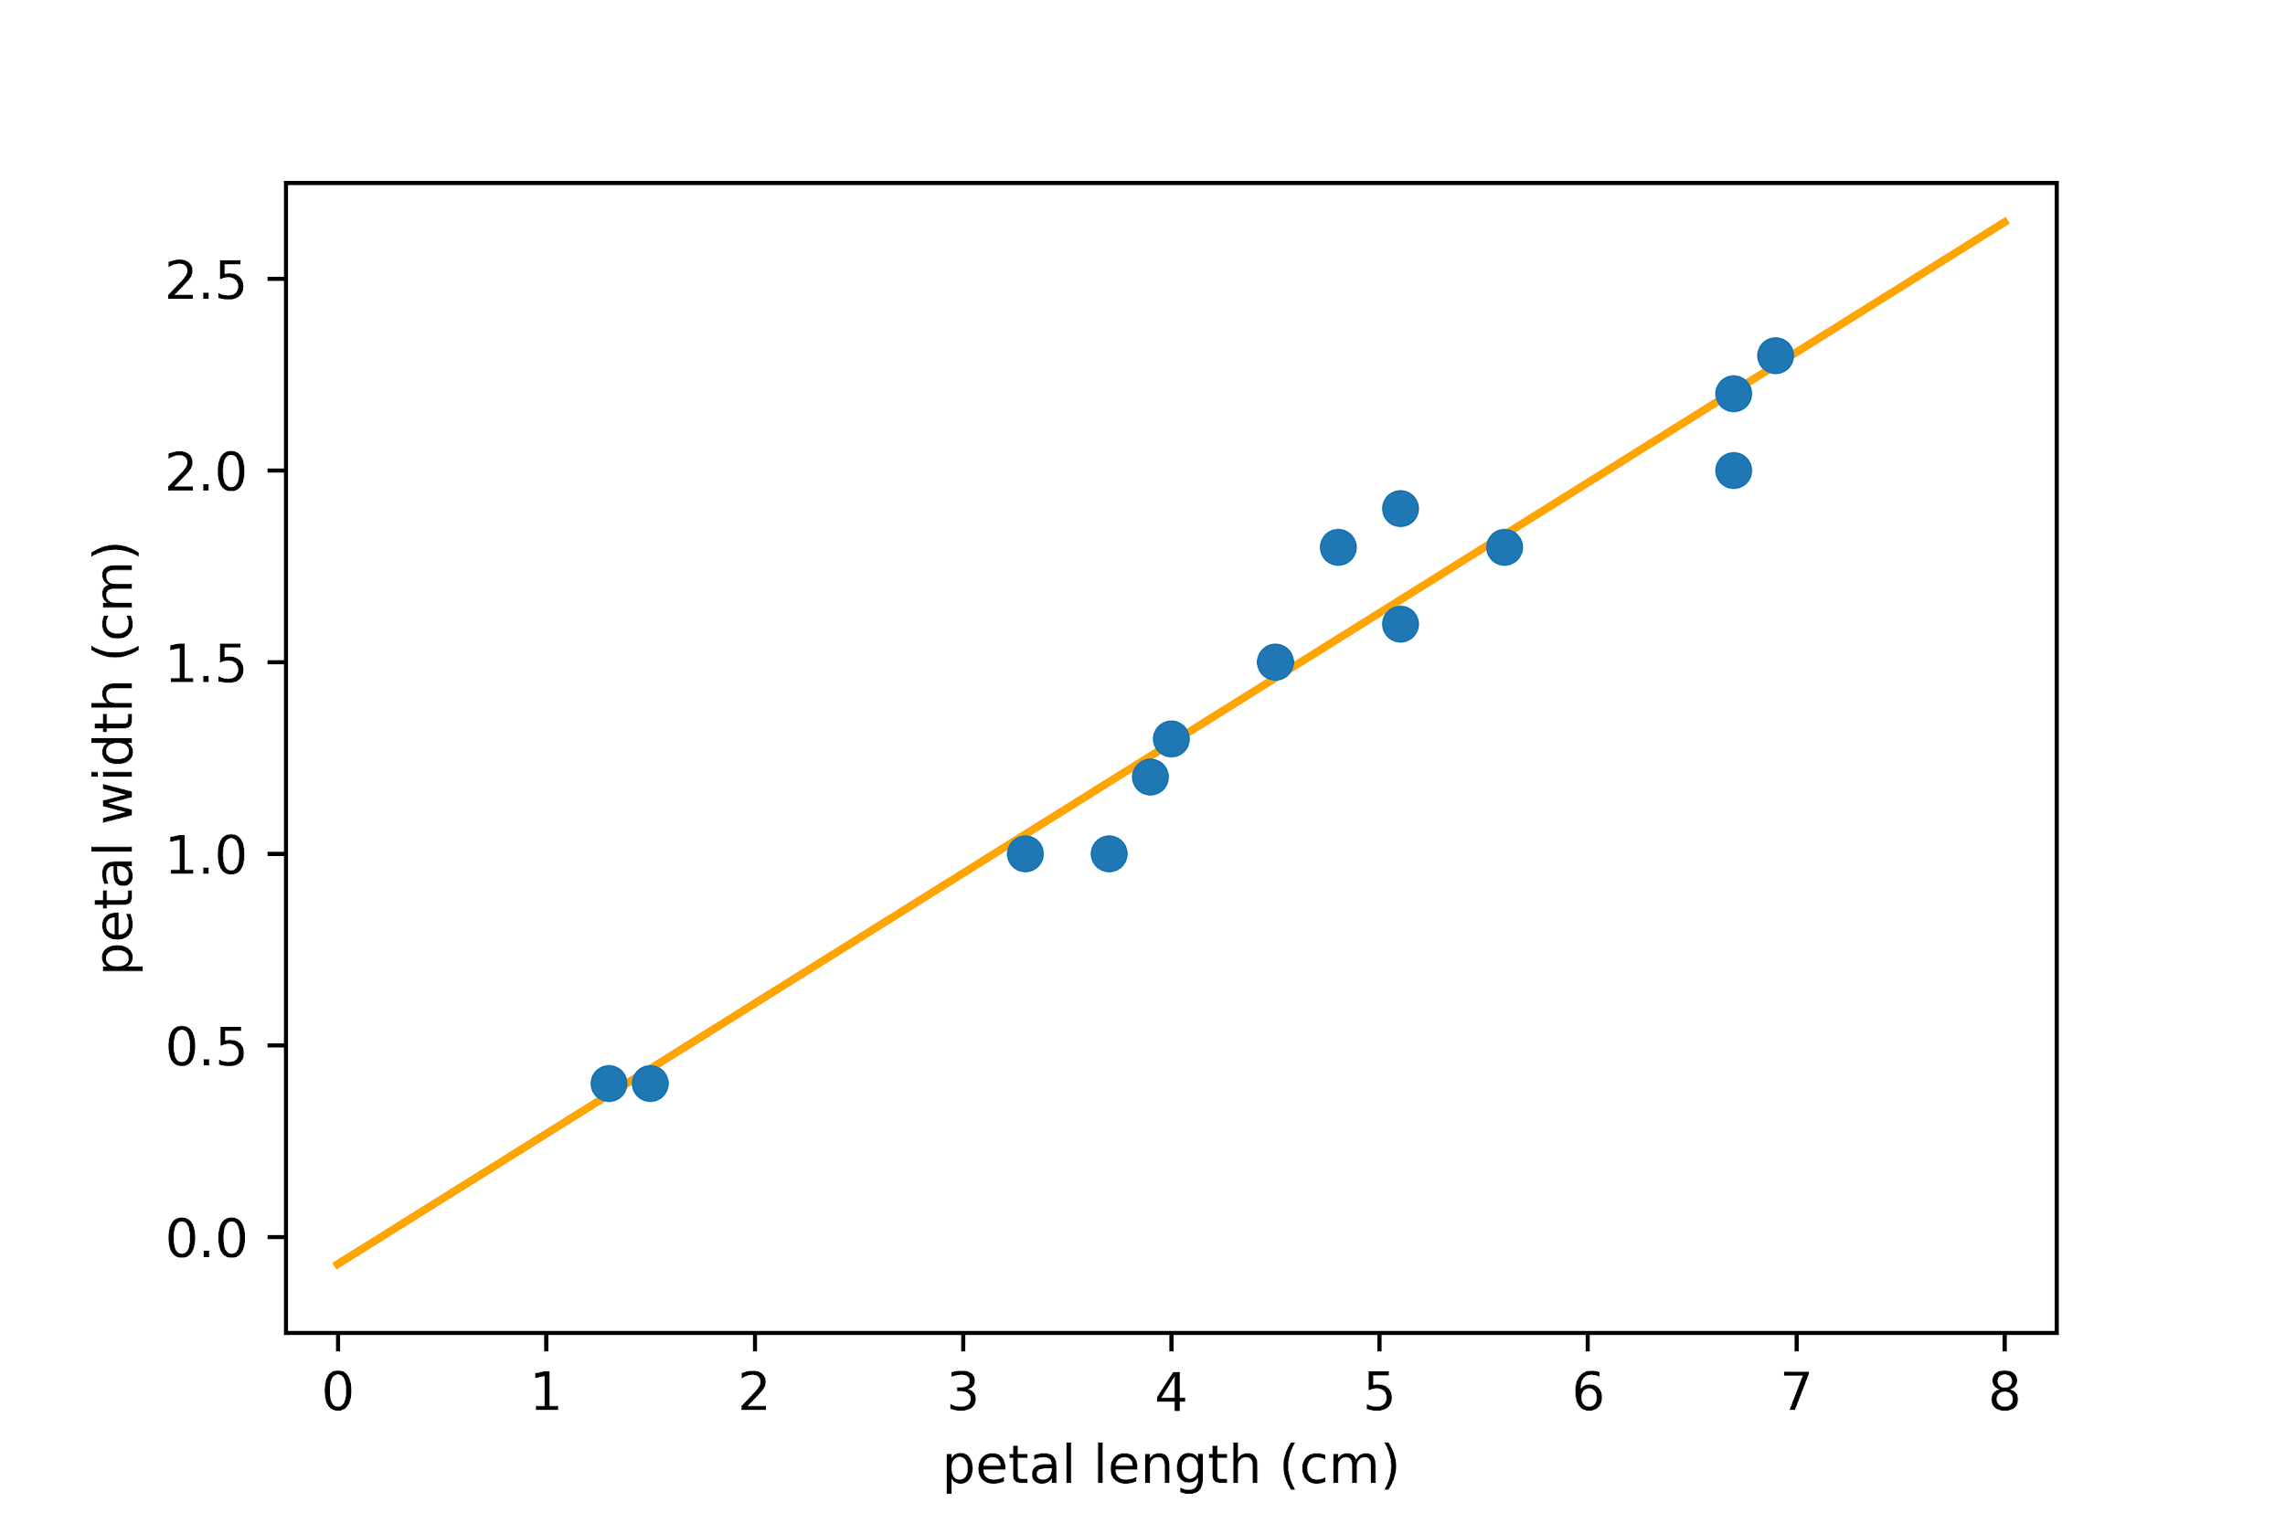
Result!
Does the least squares estimate result in the line of best fit visually?

Slide 31
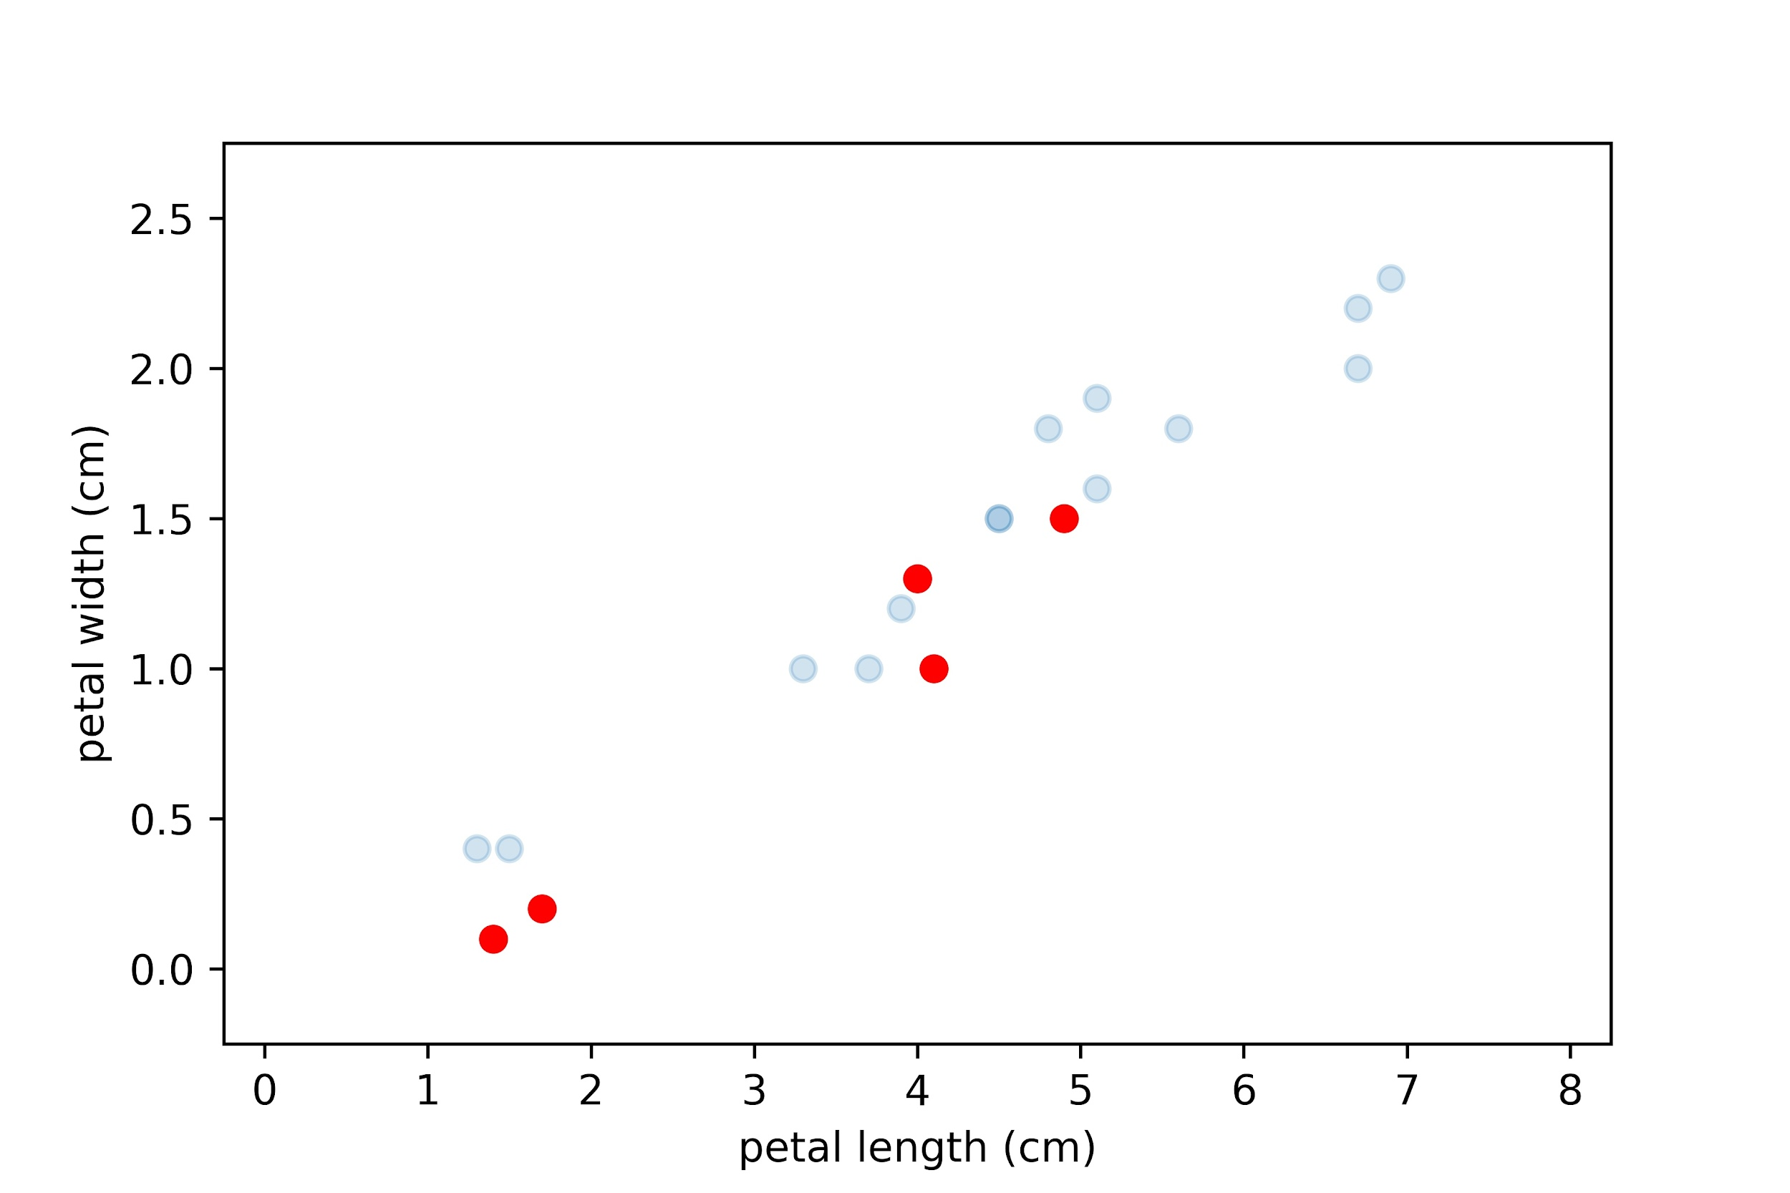
Predicting the labels for new observations
Does our model generalise to the data we have not seen before?

Slide 32
What to do if the output depends on more input variables?
Not all regression problems can be simplified as Simple Linear Regression. We often need to include more inputs in our model!
Let’s revisit our dataset, which now has another feature, Hours of Sleep
Student | Hours of Study | Hours of Sleep | Exam Score
Abdullah | 2 | 7 | 67
Aroob | 4 | 4 | 62
Aminah | 3 | 5 | 61
Azka | 6 | 6 | 93
Summiya | 5 | 4 | 70
Owais | 4 | 6 | 76
Tim | 7 | 4 | 71
Liza | 3 | 8 | 69
Martin | 1 | 8 | 52

Slide 33
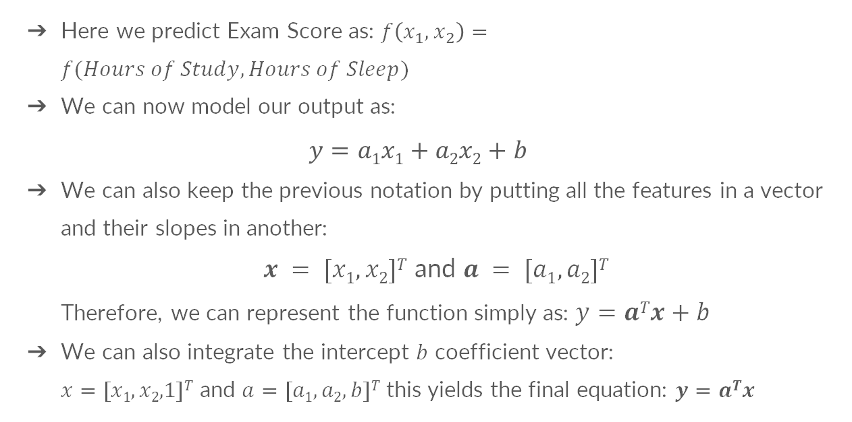
Extending to higher dimensional features
Here we predict Exam Score as: $f\left(x_{1},x_{2}\right)=f(Hours of Study, Hours of Sleep)$
We can now model our output as:
$$y=a1x1+a2x2+b$$
We can also keep the previous notation by putting all the features in a vector and their slopes in another:
$x = [x1,x2]T$ and $a = [a1,a2]T$
Therefore, we can represent the function simply as: $y=aTx+b$
We can also integrate the intercept $b$ coefficient vector:
$x=[x1,x2,1]T$ and $a=[a1,a2,b]T$ this yields the final equation: $y=aTx$

Slide 34
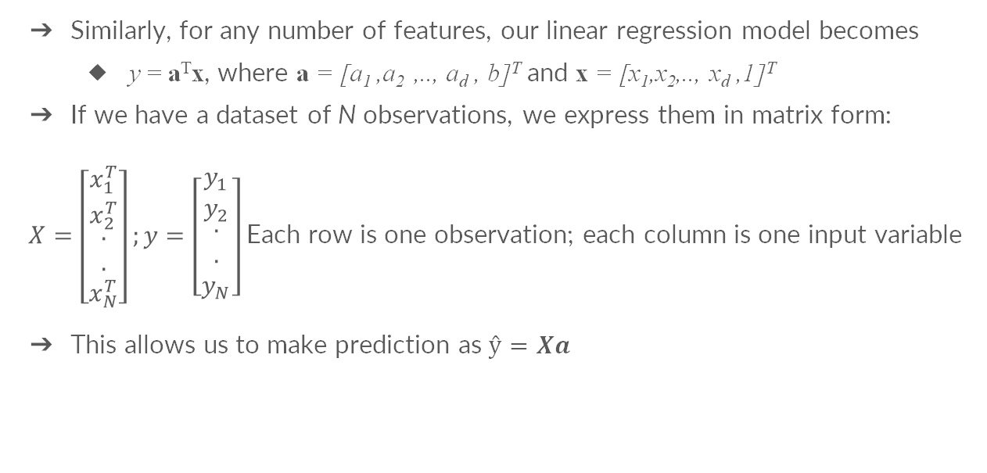
Extending to higher dimensional features
Similarly, for any number of features, our linear regression model becomes
y = a^{T}x, where a = [a₁ ,a₂ ,.., a_{d} , b]^{T} and x = [x₁,x₂,.., x_{d} ,1]^{T}
If we have a dataset of N observations, we express them in matrix form:
$X=\left[\begin{matrix}x_{1}^{T} \\ x_{2}^{T} \\ \begin{matrix}. \\ . \\ x_{N}^{T}\end{matrix}\end{matrix}\right];y=\left[\begin{matrix}y_{1} \\ y_{2} \\ \begin{matrix}. \\ . \\ y_{N}\end{matrix}\end{matrix}\right]$ Each row is one observation; each column is one input variable
This allows us to make prediction as $ŷ=Xa$

Slide 35
Implementation on Google Colab
Objective 1: Learn a Linear model to predict Exam score using StudyHours and SleepHours
Objective 2: Using Scikit-Learn, fit a Linear model to predict “petal width” from “sepal width, sepal length and petal length”
Extra: Visualize how the data looks like when you plot petal length against the other 3 variables.

Slide 36
Congratulations! 🥳
You have just:
Learnt about the basics of machine learning;
Learnt the theory to build a linear regression model from scratch
Next week you will learn about:
...classification tasks and the logistic regression model,
...and more!
And now time to get some hands on experience!!
Learn how to train a linear regression model from scratch in Python using both the Iris dataset and the house pricing dataset!
Have fun and don’t hesitate to ask questions to all the helpers!
PLEASE SHARE YOUR FEEDBACK WITH US (2mins) 😊!

